Slide 1

Angular Session 1

Slide 2
Agenda
What is Single Page Application (SPA) ?
What and Why Angular?
Angular CLI and Creating an Angular Application
Angular Architecture
Angular Core Concepts
Angular Components
Angular Component Communication

Slide 3
What is Single Page Application (SPA) ? (1/2)
SPAs are usually used to describe applications that were built for the web. These applications are accessed via a web browser like other websites but offer more dynamic interactions resembling native mobile and desktop applications.
The most notable difference between a regular website and a SPA is the reduced amount of page refreshes. SPAs have a heavier usage of AJAX — a way to communicate with back-end servers without doing a full-page refresh — to get data loaded into the application. As a result, the process of rendering pages happens mostly on the client-side.
In a SPA, either all necessary code – HTML, JavaScript and CSS – is retrieved with a single page load or the appropriate resources are dynamically loaded and added to the page as necessary, usually in response to user actions.
The page does not reload at any point in the process, nor does control transfer to another page, although the location hash or the HTML5 History API can be used to provide the perception and navigability of separate logical pages in the application.
The main page consists of a place holder which displays the child pages.

Slide 4
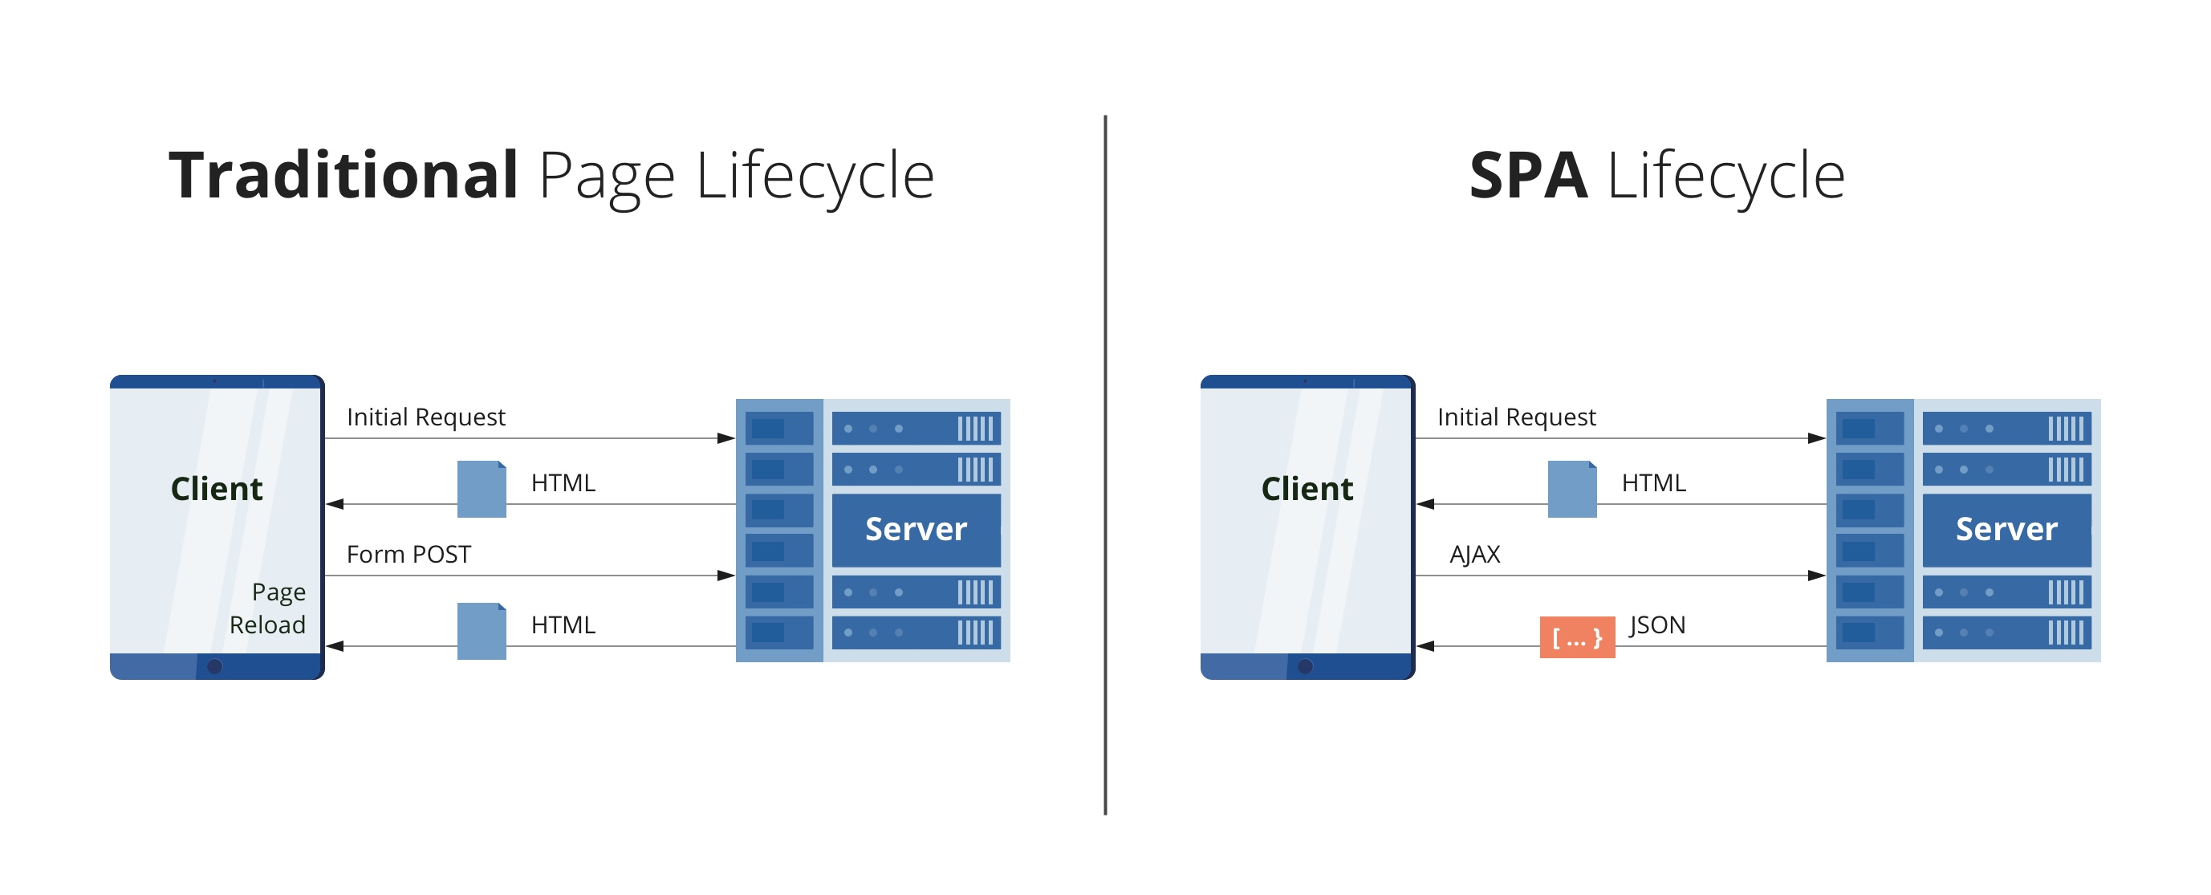
What is Single Page Application (SPA) ? (2/2)
A Comparison of Single-Page and Multi-Page Applications - DZone

Slide 5
Dynamic Websites vs Static Pages vs Single Page Apps (1/3)
Understanding the differences between three types of Web applications.
How the web works - the browser sends a requests, the server returns a response. If a webpage was requested, the response contains HTML code which then is used by the browser to render the website.
But how does the HTML code, which is returned, end up on the server?
Is it generated "on the fly" (per request)?
Is it "pre-generated" (i.e., are the finished HTML pages uploaded onto the server)?
Let’s understand it with a comparative study

Slide 6
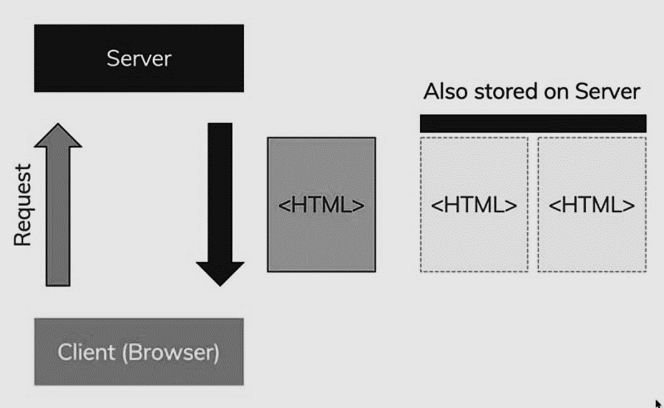
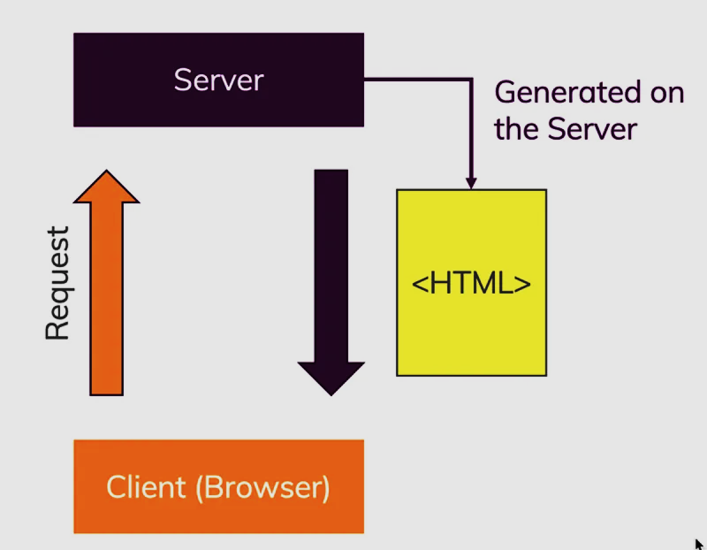
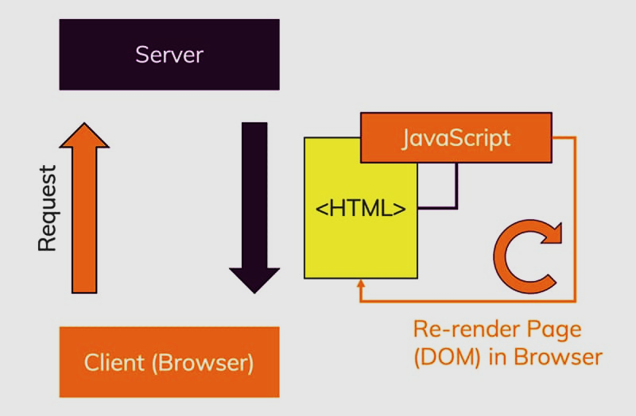
Dynamic Websites vs Static Pages vs Single Page Apps (2/3)
Static Web Application
HTML pages were pre-generated and are stored as such on the server - typically, those pages are not hand-written but also generated automatically (but before they're uploaded) with the help of a static site generator.
Dynamic Web Application
HTML pages are created dynamically, on the server - with the help of a server-side programming language and typically also a "templating engine"
Single Page Applications
The server returns one single, pre-generated HTML page which in turn contains JavaScript code that changes the page dynamically in the browser (this approach is known as a "Single Page Application" or "SPA")

Slide 7
Dynamic Websites vs Static Pages vs Single Page Apps (3/3)
Pros. and cons. | Dynamic | Single Page Application | Static
Pros. | Final content is returned, so, great from SEO perspective All heavy lifting will be done at server side | Highly reactive, mobile like applications No page reload waiting time | Readymade static html pages will be delivered from servers. So, it great for SEO Performance wise faster because all static html pages are already created
Cons. | Every new page must be loaded Frontend and backend developer are harder to split | Final content is created in browser. So, SEO can be more difficult Heavy lifting will be done in browser | No Dynamic changes in data Developers must modify contents

Slide 8
Agenda
What is Single Page Application (SPA) ?
What and Why Angular?
Angular CLI and Creating an Angular Application
Angular Architecture
Angular Core Concepts
Angular Components
Angular Component Communication

Slide 9
Why Angular?
SPA is fast, as most resources (HTML+ CSS+ Scripts) are only loaded once throughout the lifespan of application. Only data is transmitted back and forth. The development is simplified.
Business logics can implement in .ts class files
Built on top of Type Script
Component Based Frameworks
Multiple Components can be integrated
Client Server Communication
Routing
Libraries and modules for communications
Angular routing made navigation super easy
Data Binding
Angular Form
Data binding, property binding can be done
Provides Template driven and Reactive forms

Slide 10
Angular Versioning…
Angular 1.0 /Angular JS | Which is known as AngularJS, was released in 2010 by Google. Angular JS was controller-based framework. Angular JS had many issues therefor Angular team rewritten Angular with component-based approach which become so popular these days.
Angular 2.0 | Angular 2.0 was released in September 2016 by Google angular team. From this version development of Angular applications got changed completely. From Angular 2.0, development was component-based.
Angular - 4.0, 5.0, 6.0, 7.0, 8.0, 9.0 | Angular 3.0 was skipped then team started with Angular 4.0, 5.0 in 2017, 6.0, 7.0 in 2018, 8.0 in 2019, 9.0 in 2020. But all versions having backward compatibility and added some new features. Like Angular elements added in Angular 6.
Angular 10, 11, 12,13, 14 | Angular 10 released in June 2020, Angular 11 released in Nov 2020. Angular 12 released in May 2021 Angular 13 released in Nov 2021 and recent version Angular 14, released in Jun 2022. Note:- If any developer familiar with Angular 2.0 then that developer can work with any of version starting Angular 2.0 to 14.

Slide 11
Agenda
What is Single Page Application (SPA) ?
What and Why Angular?
Angular CLI and Creating an Angular Application
Angular Architecture
Angular Core Concepts
Angular Components
Angular Component Communication

Slide 12
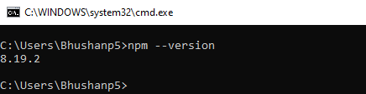
Angular CLI (1/5)
In order to understand Angular application structure and Angular architecture, We will first understand Angular CLI and how to create first angular application.
Step 1: We will have to install Node js from official web site. https://nodejs.org/en/download/
Step 2: Download and install node js with respect to your operating system. After installation fire command npm - -version.
Step 3: Now we will have to install angular CLI. For this we will have to fire command. It will start installing angular CLI.

Slide 13
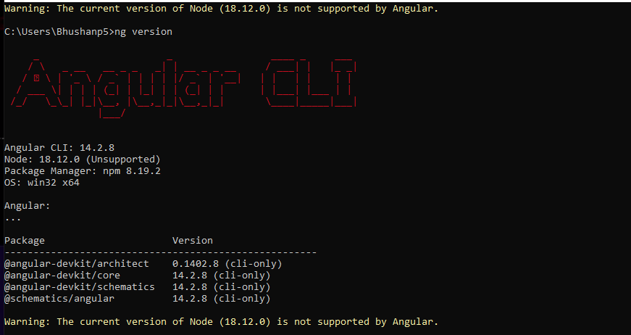
Angular CLI (2/5)
Step 4: Once installation will be done simply fire command. Ng version which will shows us version of angular CLI.

Slide 14
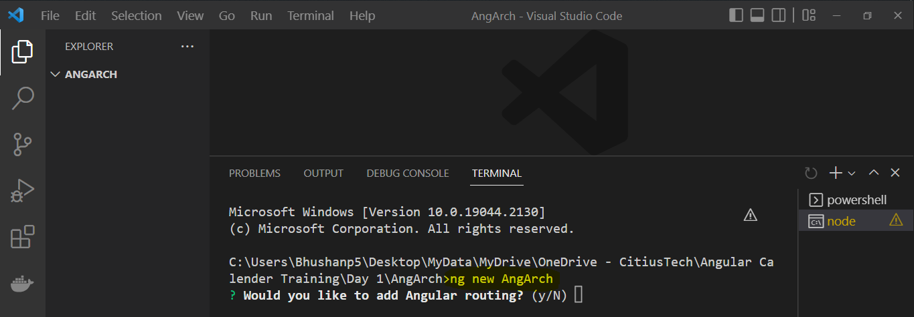
Angular CLI (3/5)
Step 5: In order to create our first Angular Application, we will create a new folder and we will open it with VS code.
Step 6: Once this folder will be opened in VS Code then press “ctrl+`”. This will open terminal in VS Code.
Fire command: ng new AppName and then press Y for adding routing module.

Slide 15
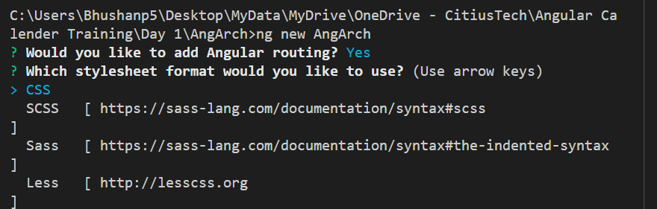
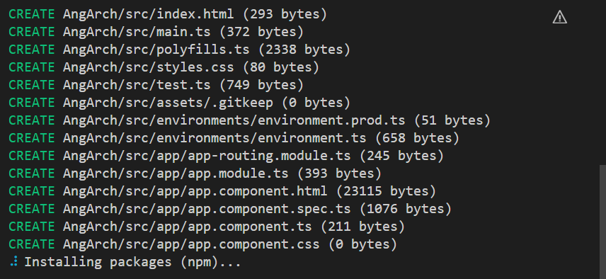
Angular CLI (4/5)
Step 7: Then keep CSS selected and press enter.
It will build an angular application for you. It may take some time.

Slide 16
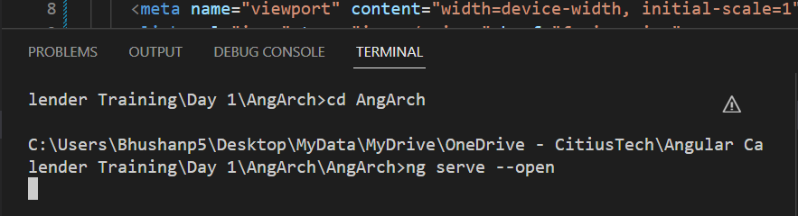
Angular CLI (5/5)
Step 8: Once our project Will be created, we will simply run our application by firing command ng serve - -open.
This command will run our application and it will be rendered on web browser.

Slide 17
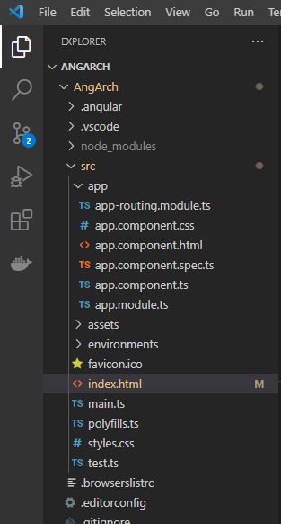
Creating an Angular Application – Files and Folders (1/10)
Now we will see Folder structure of Angular application. We will try to understand angular architecture now. Here we can see some folders and files created after creation of new angular project.

Slide 18
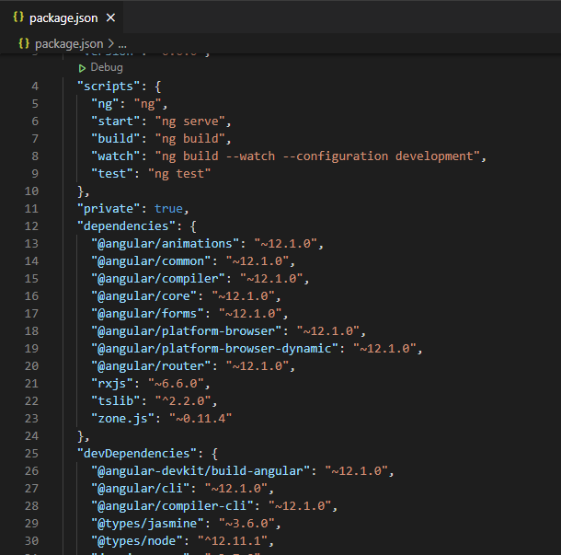
Creating an Angular Application – Files and Folders (2/10)
Package.json
This file contain scripts, basic dependencies and dev dependencies and version information.
Scripts- It will consist of different command with its script. Like to start – ng serve.
Version – It will display versions of all dependencies.
Dependencies – It consist of all dependencies which are required for our project.
DevDependencies- It consist of third part dependencies. Example- if we want to use gmap in our application then we can add it in dependencies.

Slide 19
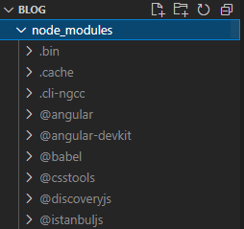
Creating an Angular Application – Files and Folders (3/10)
Node_modules
This folder contains all required modules which are mentioned in Package.json file.

Slide 20
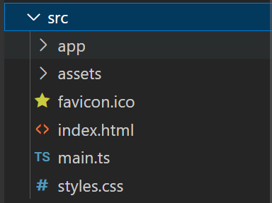
Creating an Angular Application – Files and Folders (4/10)
Src folder
SRC – Folder is most important folder for our application. Because 95% of our work will be done only in this folder. If we will add any new component, css files, images those will be added in SRC folder under subfolders in it.
It consist of three major folders:
App - In which app components and its modules and respective compo are present.
Asset - It consist of resources required for our applications like images, css files.
index.html - It is a simple html documents.
main.ts - It is an important file for bootstrapping process.

Slide 21
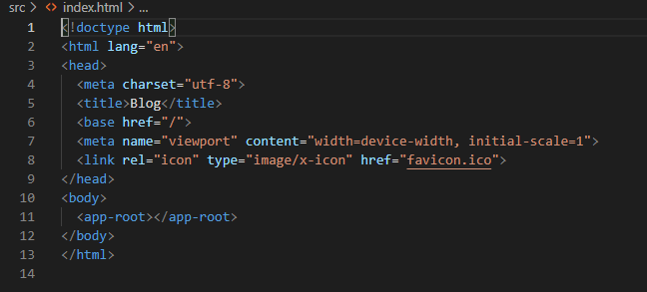
Creating an Angular Application – Files and Folders (5/10)
index.html
This is first page or entry point for angular application. Index.html page will be rendered on browser first further we can get other components on it.

Slide 22
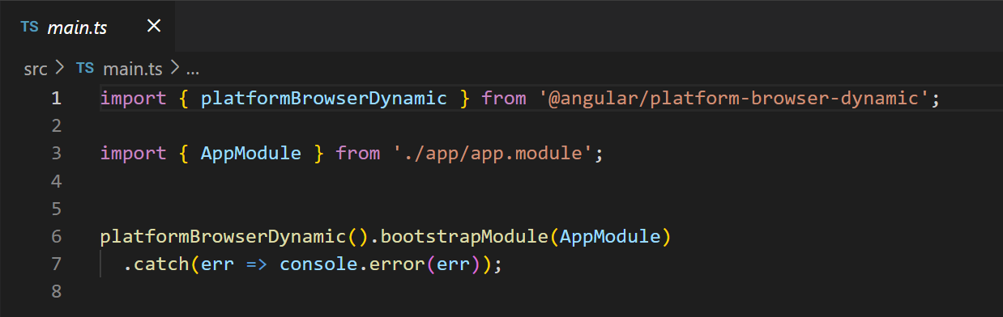
Creating an Angular Application – Files and Folders (6/10)
main.ts
It is a .ts class file which plays very important role in bootstrapping process.
Bootstrapping is process of starting angular application. We will discuss Bootstrapping process soon.

Slide 23
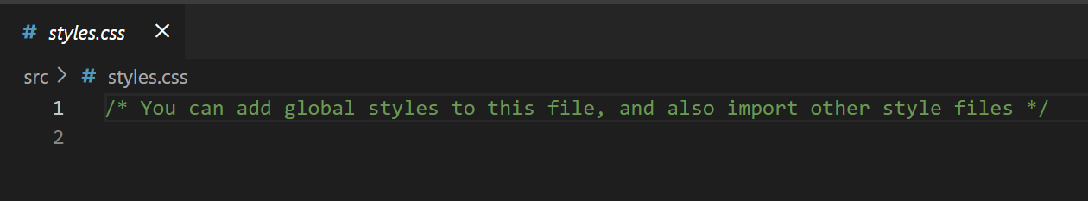
Creating an Angular Application – Files and Folders (7/10)
Styles.css
If you want to style globally in angular application, we can add our css code here in this file.
In angular application, for each component there will be dedicated css file.

Slide 24
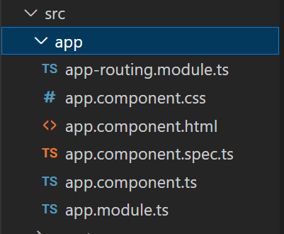
Creating an Angular Application – Files and Folders (8/10)
App folder
App – This is root component of angular application. It will be added automatically while creating new project.
app.component.css – This file contain stylesheet for app component. For app.component.html we can write css code.
app.component.html – In this file we will have to develop our HTML code for creating view for our app component html page. This file also called as Template.
app.component.spec.ts – It specify testing code in order to perform testing on app component.
app.component.ts – It is important one because we have to write logic in this file.
app.module.ts – to mentions modules information.
app-roting.module.ts- This will add routing data means if we have to navigate within resources we need to mention in this file.

Slide 25
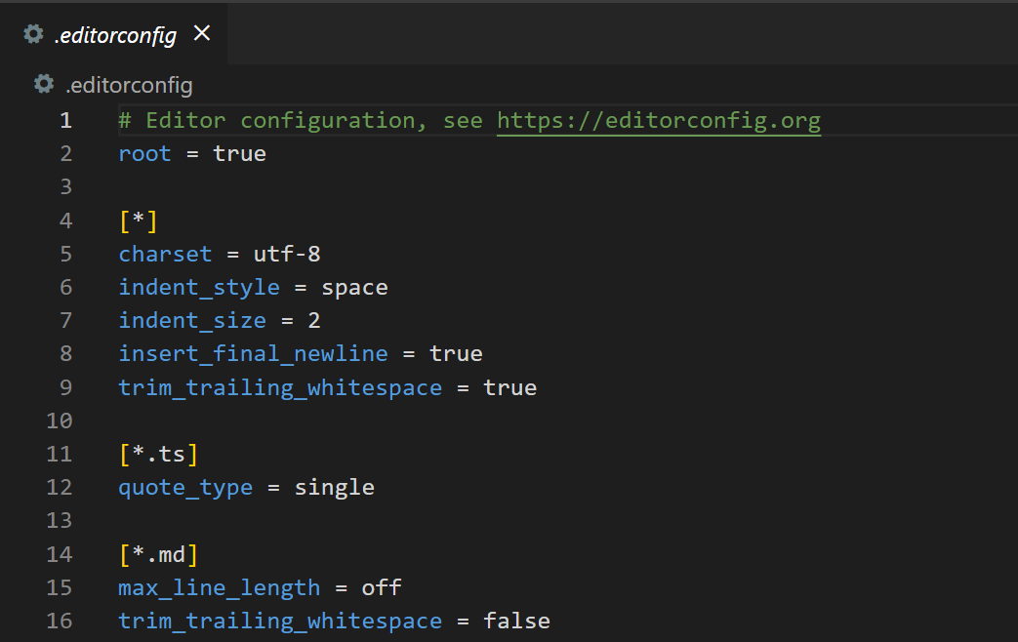
Creating an Angular Application – Files and Folders (9/10)
.editorconfig
This file consist of only information about editor. There are lots of editor available to develop Angular projects so for all of them we need to do some configuration. Here we can see in picture that What will be charset, indent_style, indent_size and many more……

Slide 26
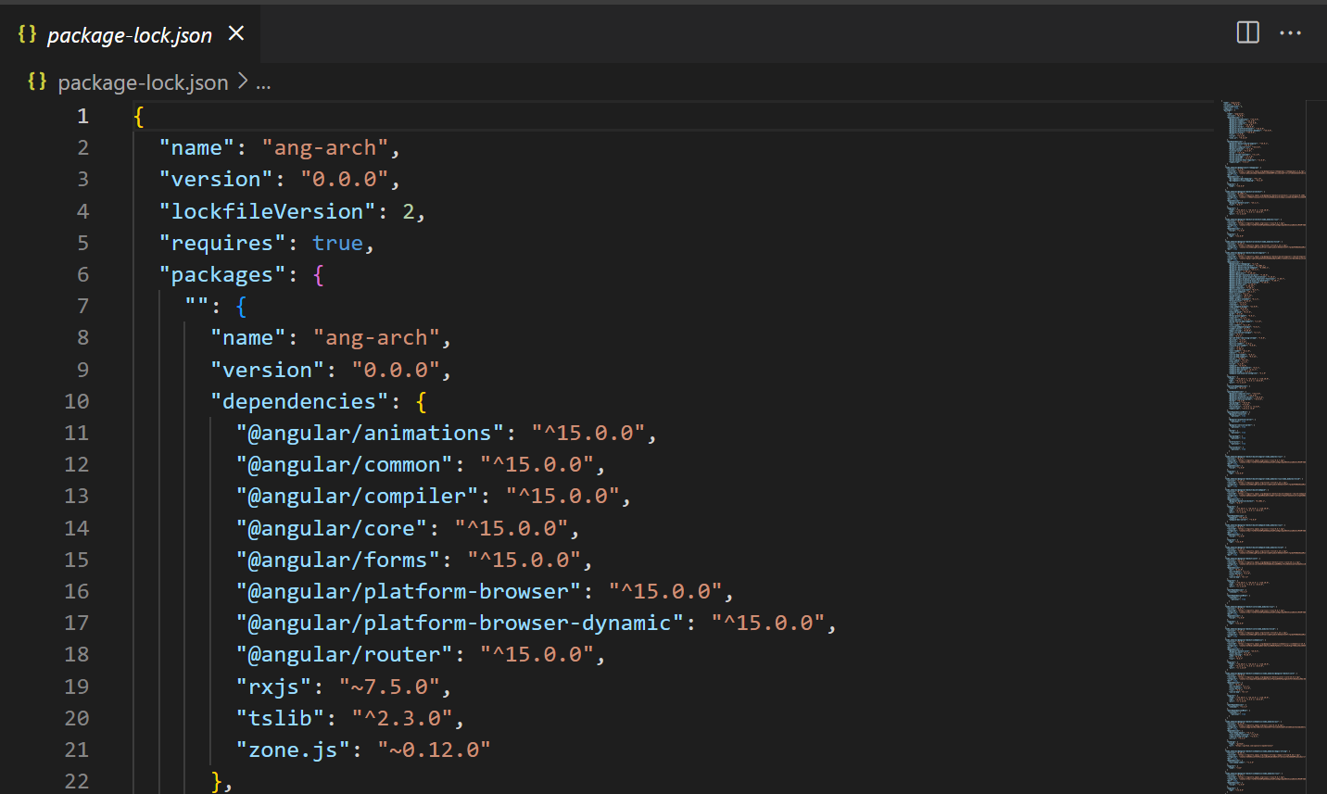
Creating an Angular Application – Files and Folders (10/10)
.package-lock.json
A package.json file which included dependencies but package-lock.json file consist list of all modules which mentioned in package.json along with all other sub dependencies.

Slide 27
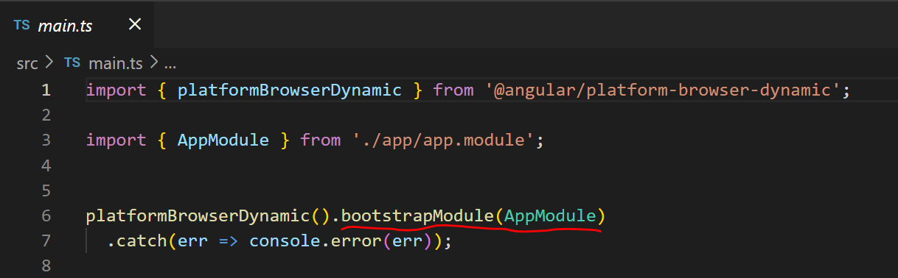
Bootstrapping Angular Application (1/4)
Bootstrapping is process of starting root module / App module.
Once app module get start then it handles other modules. So, entry point of Angular application is main.ts file.

Slide 28
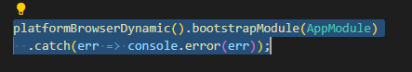
Bootstrapping Angular Application (2/4)
Here we will see how angular load first component as a startup component in our application.
Here we can see bootstrapModule(AppModule). So, angular will load AppModule first. here we can say Angular will decide which module to be loaded.
The platformBrowserDynamic() method boots the angular into the browser environment.
bootstrapModule() this function helps to bootstrap our root module, AppModule is passed as root module as an argument. We can also change this root module but by default AppModule is our root module.
Note: In order to replace root module, we will have to add “import { BrowserModule } from '@angular/platform-browser’;” in our module-name.module.ts.

Slide 29
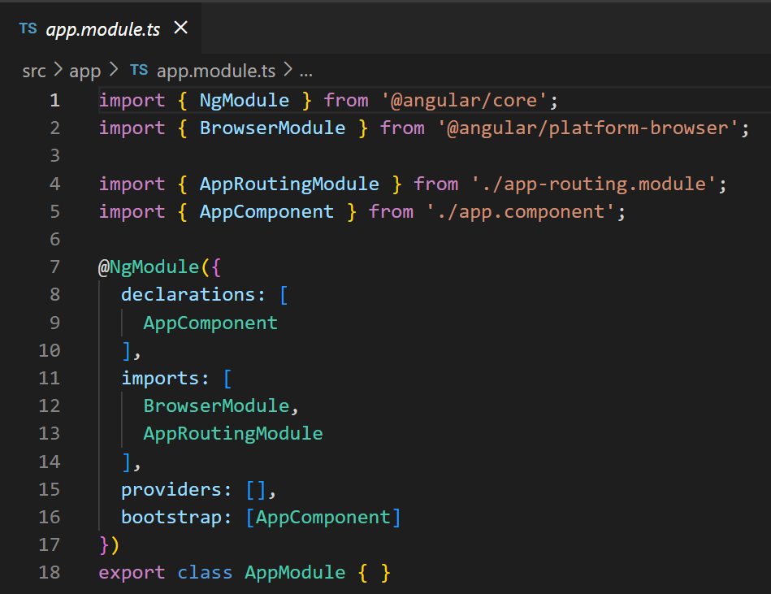
Bootstrapping Angular Application (3/4)
If we will press F12 by selecting AppModule then it will open app.module.ts file, where there are declarations, imports, providers and most important is bootstrap component.

Slide 30
Bootstrapping Angular Application (4/4)
If we will press F12 by selecting AppModule then it will open app.module.ts file, where there are declarations, imports, providers and most important is bootstrap component.
In array of bootstrap, we can specify which components should get loaded at the time of bootstrapping.

Slide 31
Agenda
What is Single Page Application (SPA) ?
What and Why Angular?
Angular CLI and Creating an Angular Application
Angular Architecture
Angular Core Concepts
Angular Components
Angular Component Communication

Slide 32
Angular Architecture
Start angular application by bootstrapping root module. Ex: like car engine, use key to start
Engine.
Bootstrapping
main.ts
Services blueprint
Injector
Provider
Service
Instances
NgModules
(It works like manager. It also requires some stuffs which can import)
Imports
(When we requires features from other modules )
Exports
(When we have to share some features to other modules)
Create a service instance from blueprint provided by provider
Property Binding
Declaration
View
Html
+
Angular Markup
(directives, pipes)
Component
(App-Component)
Template
This is called dependency injection
When service will be required by component then it will be injected by injector
Event Binding

Slide 33
Agenda
What is Single Page Application (SPA) ?
What and Why Angular?
Angular CLI and Creating an Angular Application
Angular Architecture
Angular Core Concepts
Angular Components
Angular Component Communication

Slide 34
Angular Core Concepts
Modules
Components
Directives
Pipe
Services
Angular applications are modular and Angular has its own modularity system called NgModules
Components are the main building block for Angular applications
In Angular, Directives are defined as classes that can add new behavior to the elements in the template or modify existing behavior.
In Angular, Pipes are used to transform data. It was transforming strings, currency amounts, dates, and other data for display
Services provides specific functionality in an Angular application.
Services is one of the most important entity.

Slide 35
Modules (1/5)
Angular applications are modular and Angular has its own modularity system called NgModules.
NgModules are containers for a cohesive block of code dedicated to an application domain, a workflow, or a closely related set of capabilities.
They can contain components, service providers, and other code files whose scope is defined by the containing NgModules.
They can import functionality that is exported from other NgModules, and export selected functionality for use by other NgModules.
Every Angular application has at least one NgModule class, the root module, which is conventionally named AppModule and resides in a file named app.module.ts. You launch your application by bootstrapping the root NgModule.

Slide 36
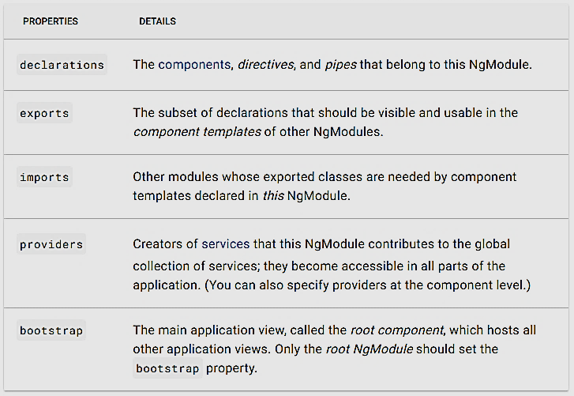
Modules (2/5)
An NgModule is defined by a class decorated with @NgModule(). The @NgModule() decorator is a function that takes a single metadata object, whose properties describe the module. The most important properties are as follows:

Slide 37
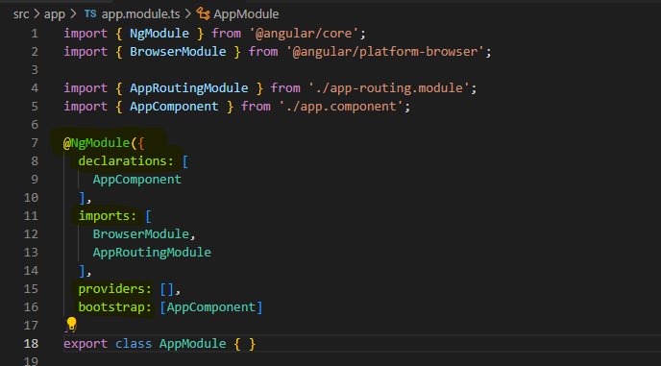
Modules (3/5)
Each Angular application will must contain at least one module that is app module. It can be seen by opening the file app.module.ts file.

Slide 38
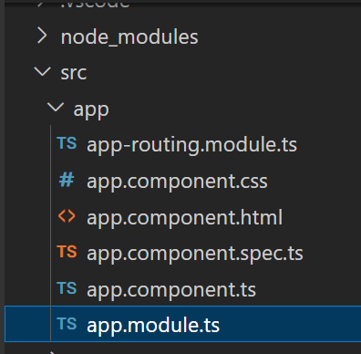
Modules (4/5)
Each Angular application will must contain at least one module that is app module. It can be seen by opening the file app.module.ts file.

Slide 39
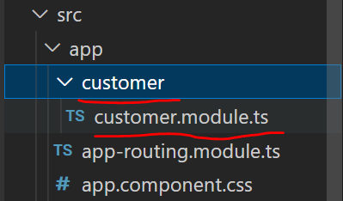
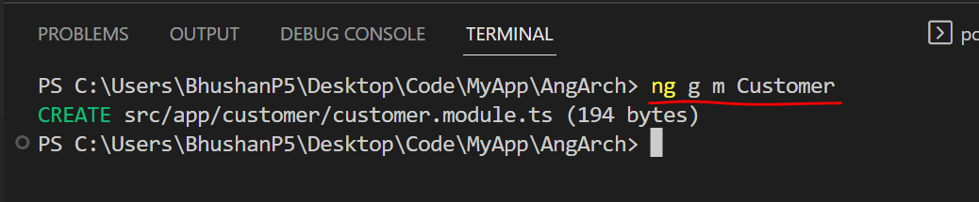
Modules (5/5)
Scenario, where we can create Modules in Angular Application.
You are working on frontend development of an E-Commerce application, you will be responsible for developing customer related functionality like customer registration, customer login, customer forget password and some more. So, in such scenarios concept of modularity will be very helpful. You can create a customer module for implementing these all components.
How to create new module?
Ans. Fire a command ng g m module_name or ng generate module module_name.
Let’s create a Customer module in order to start your development process.
Step 1. Open terminal of VSCode or any IDE which you are using or CMD with respect to project in which you will have to create new module and fire a command
ng g m Customer

Slide 40
Components in Angular (1/3)
Angular applications are made up of components, therefor it is called as Component based framework
Components are the main building block for Angular applications. Each component consists of:
An HTML template that declares what renders on the page
A TypeScript class that defines behavior
A CSS selector that defines how the component is used in a template
A TypeScript class file for writing unit test cases
In order to create component, we will have to fire command:
ng g c component_name
ng generate component component_name

Slide 41
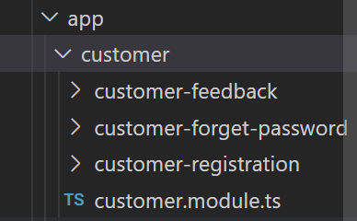
Components in Angular (2/3)
Consider same scenario for which we have created Customer module. Your next responsibility is to create three functionalities like:
CustomerRegistration
CustomerForgetPassword
CustomerFeedback
So, for each of them we will create three different components.
For doing so, we will have to file given below commands:
ng g c Customer/CustomerRegistration
ng g c Customer/CustomerForgetPassword
ng g c Customer/CustomerFeedback
Above commands created three components in Customer module.

Slide 42
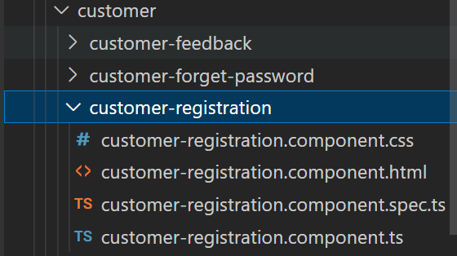
Components in Angular (3/3)
Each components in Angular is made up of four files. So, components which we have created, each component is also consisting of four files.
Let’s open customer-registration component.
Let’s have look on all four files..

Slide 43
Directives
In Angular, Directives are defined as classes that can add new behavior to the elements in the template or modify existing behavior.
The purpose of Directives in Angular is to maneuver the DOM, be it by adding new elements to DOM or removing elements and even changing the appearance of the DOM elements.
Types of Directives in Angular:
Component Directive
Special directives in Angular are called Components since this type of directive has a template or template URLs. In effect, it is a component directive that shows something in DOM.
Structural Directive
This type of directive is used to make changes in the layout of the DOM. Elements can be added or removed, hence changing the structure of the DOM. An example would be *ngIf(adding or removing element from DOM) or *ngFor(lists elements of every iteration).
Attribute directive
This type of angular directive is used to make behavior or element changes in the appearance and behavior of an element. For example, ngStyle( applying styles) or ngClass(applying CSS classes).
Custom Directives
We can create our own directive to implement customized behavior.

Slide 44
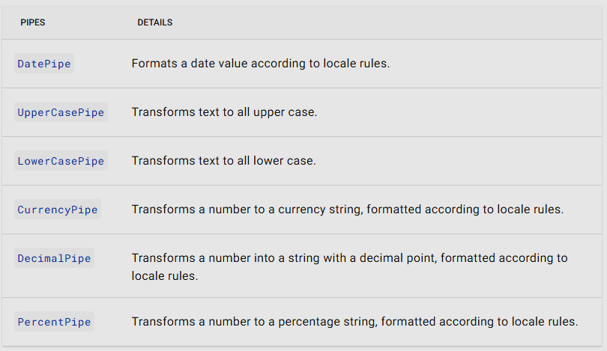
Pipes (1/2)
General Definition: Pipes are nothing but functions which is used to transform data.
Technical Definition: Pipes are simple functions to use in template expressions to accept an input value and return a transformed value. Pipes are useful because you can use them throughout your application, while only declaring each pipe once. For example, you would use a pipe to show a date as April 15, 1988, rather than the raw string format.
Angular provides built-in pipes for typical data transformations, including transformations for internationalization, which use locale information to format data. The following are commonly used built-in pipes for data formatting:

Slide 45
Pipes (2/2)
In Angular 1, filters are used which are later called Pipes onwards Angular2. In Angular 7, it is known as pipe and used to transform data. It is denoted by symbol |
Syntax:
Pipe takes integers, strings, arrays, and date as input separated with |. It transforms the data in the format as required and displays the same in the browser.
For a complete list of built-in pipes, see the pipes API documentation : https://angular.io/guide/pipes
{{title | uppercase}}

Slide 46
Services (1/2)
Services provides specific functionality in an Angular application. In a given Angular application, there may be one or more services can be used. Similarly, an Angular component may depend on one or more services. In simple words we can say it’s reusable type script class.
Why use Services?
Scenario: We have a component component1 in which there is a button for displaying greet message. So, we will have to write a method for this in ts file of respective component. If we have second component and must implement same thing again. What if we will have 50 components and, in all components, we must implement same functionality?
Services can also use for component communications.
If we have to set some data which will be used in our application by multiple components, then we can use service.
Service
Greeting
Component 1
Component 2
Greeting
Greeting

Slide 47
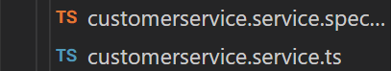
Services (2/2)
How to create service?
Service can be created manually by simply adding a new ts file in our angular application and name it as service_name.service.ts.
Service can also be created by firing command as ng g s service_name
An Angular service is plain Typescript class having one or more methods (functionality) along with @Injectable decorator. It enables the normal Typescript class to be used as service in Angular application.
Scenario: Your Team is working on Angular application, and you are responsible for Customer module. You have already created Customer module and three components in Customer module. Now, these three component may share common functionalities. So, in order to achieve this, you will have to create a service as CustomerService.
Step 1. Fire a command to create service
Above command will create service in angular application.

Slide 48
Agenda
What is Single Page Application (SPA) ?
What and Why Angular?
Angular CLI and Creating an Angular Application
Angular Architecture
Angular Core Concepts
Angular Components
Angular Component Communication

Slide 49
Angular Components
Components are the most basic UI building block of an Angular app. An Angular app contains a tree of Angular components.
Angular components are a subset of directives, always associated with a template. Unlike other directives, only one component can be instantiated for a given element in a template.
A component must belong to an NgModule for it to be available to another component or application.
To make it a member of an NgModule, list it in the declarations field of the NgModule metadata.
You can control a component's runtime behavior by implementing life-cycle hooks.
Component: Angular component is composed of four files:
component.ts → Type script class file in which we can write logic and implement functionalities.
component.html → This file is called as template in which we can design html document.
component.css → This is dedicated css file for respective template.
component.spec.ts → This file is for writing test cases to test functionality of components.

Slide 50
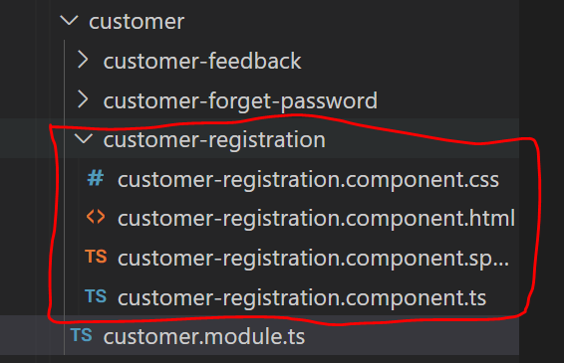
How to Create a Component?
We can create component manually but, in this case, we will have to create all four files manually and has to register in respective NgModule.
Simplest way is, use command ng g c component_name or ng generate component component_name
We have customer-registration component which we have already created.
Let’s understand all four files one by one

Slide 51
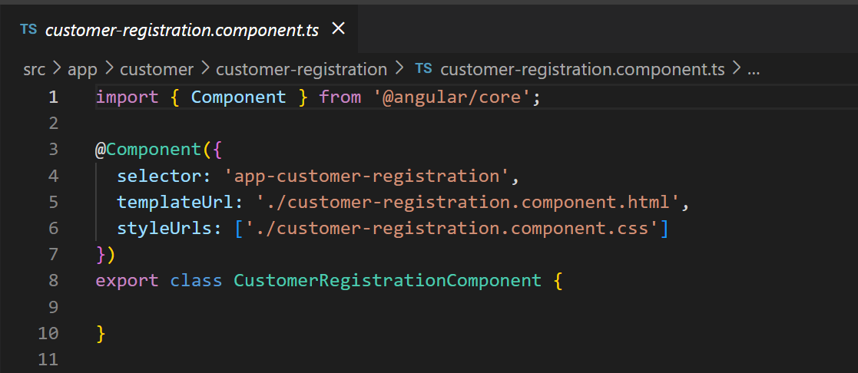
Component.ts
customer-registration.component.ts
Three important terminologies in Component
@Component -@ is called as Decorator
selector
template/templateUrl
styleUrls

Slide 52
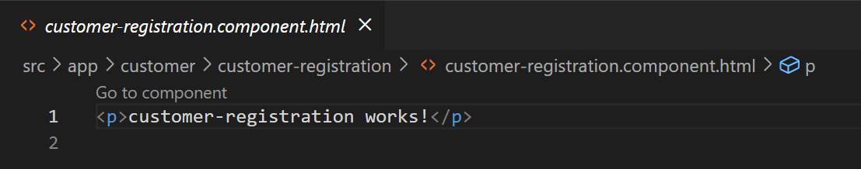
Component.html
customer-registration.component.html.
This is called as template; We can implement view for respective component.
It is nothing but a HTML document and using bindings in angular, component and ts class file can communicate with each other.

Slide 53
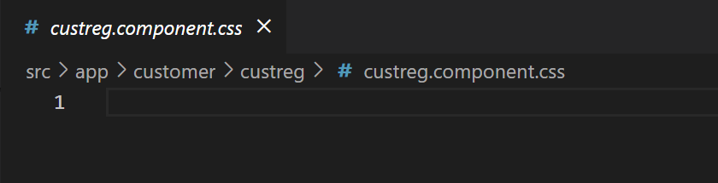
Component.css
customer-registration.component.css
It is a dedicated css file for a component. As we have seen, With every component we will get dedicated .css file for providing styles to template.

Slide 54
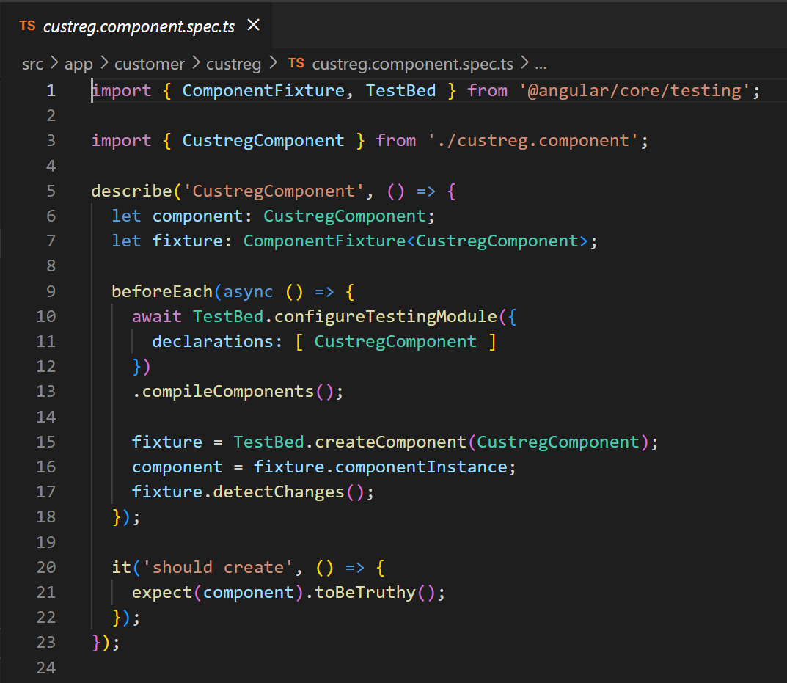
Component.spec.ts
customer-registration.component.spec.ts
This file will be added along with component for writing unit test cases for testing functionality and other modules of Angular.

Slide 55
Communication in Class and Templates using Bindings
As we have already seen component in angular has four files. One is class file, second is template that is html file, third one is css and fourth is testing ts file. So, as component communication we will see how data will be send from class to template and user action from template to class file. In order to perform such pull and push operation angular provides us four forms of binding.
Each form has binding to DOM or from DOM or in both directions.
Template (html)
Interpolation {{}}
Property Binding []
Two-way Binding[()]
Event Binding()
Class (ts)

Slide 56
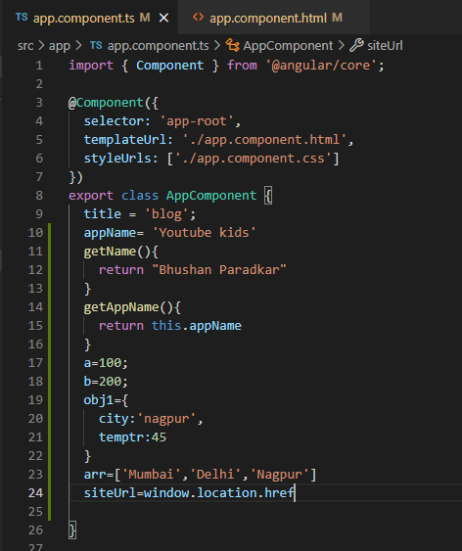
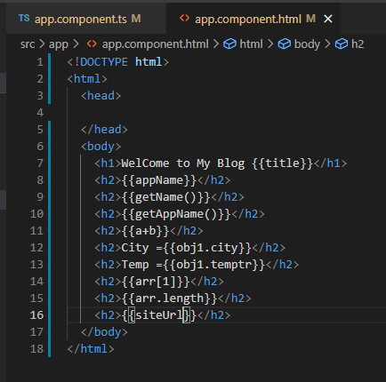
Interpolation
Interpolation (One way Binding) → We have already seen interpolation which is denoted by {{}} double curly braces. This we can say one way binding from component class to template that is HTML.
Syntax:
Here, consider title is a variable which is defined in class file
<h1>{{title}}</h1>

Slide 57
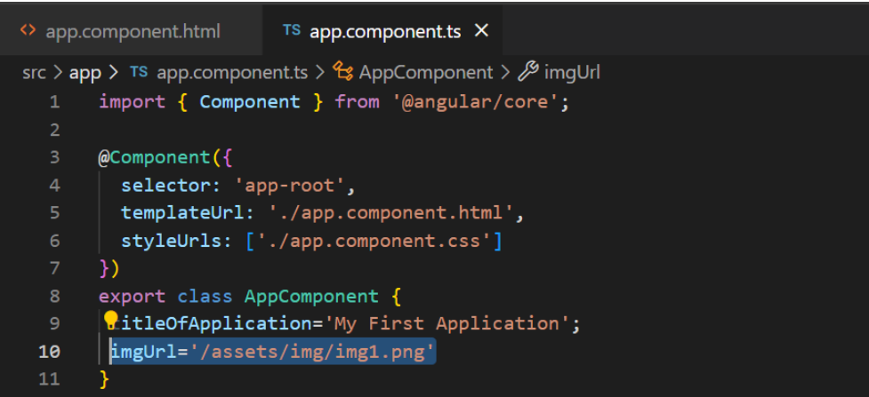
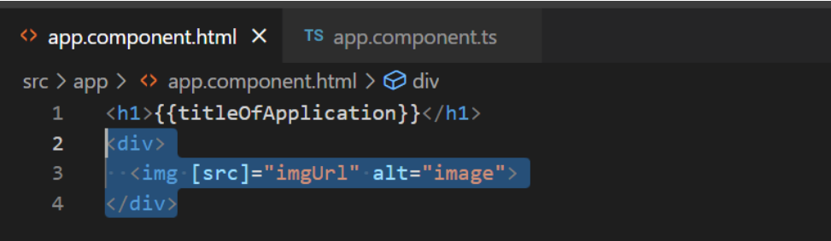
Property Binding
Property Binding: we have property binding. Which is represented by square brackets [ ]. This is also type of one-way data binding from component class to properties of template (HTML) element.
Syntax:
Assume that we have a variable as an imgUrl in ts class file.
Basic Example:
<img [src]="imgUrl" alt="image">

Slide 58
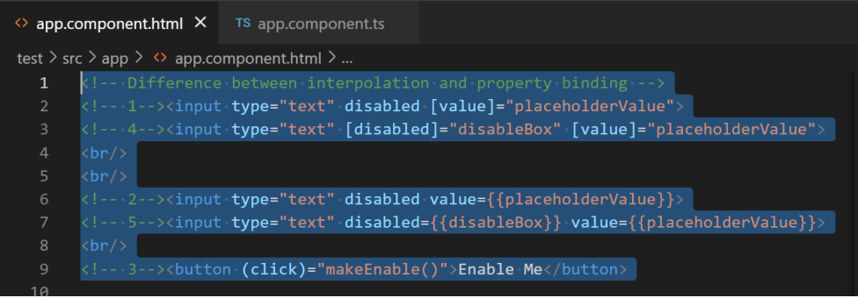
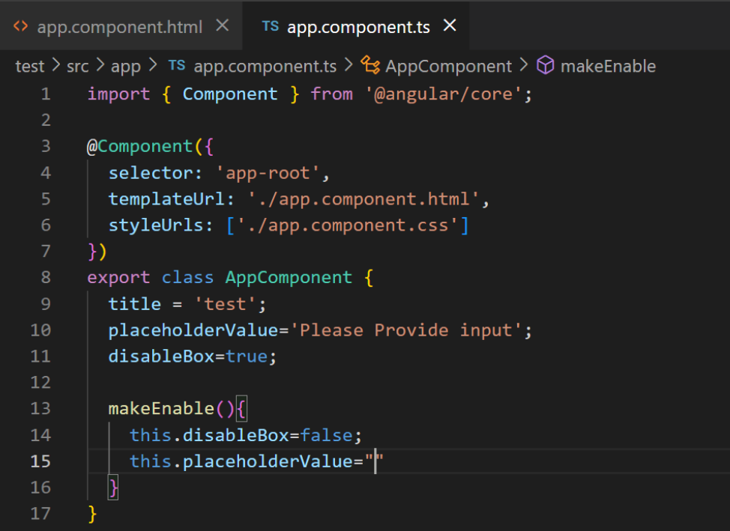
Difference Between Interpolation and Property Binding
Interpolation is used to just display a piece of data in HTML, such as displaying a title or a name. Property binding lets us bind a property of a DOM object, for example the hidden property, to some data value. More specifically, we can say property binding is used to set an element property to a non-string data value. Let’s understand it with an example
Scenario: Consider we have two text boxes in our html document. Both text boxes are disabled. Now, on button click event we have to enable text boxes. For first box, we will use interpolation and for second text box we will use property binding.

Slide 59
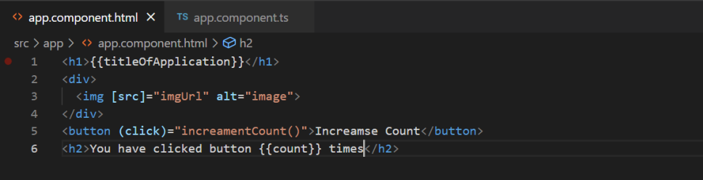
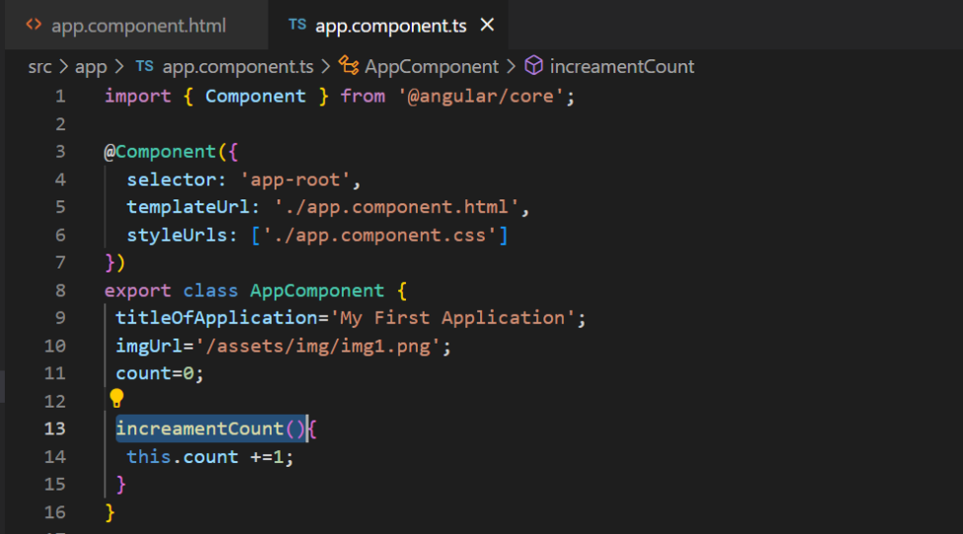
Event Binding
One-way binding from template to html that is event binding.
Means we will have to handle users’ action. When user will perform any event then it should handle using class file. So, it’s also one-way direction binding but from template to class. For this purpose, we will add an element on template and bind event with it.

Slide 60
Thank you!
Perspective from leaders across the healthcare industry
On-Demand Webinars
Reports & eBooks
Workshops
Success Stories
Articles & Blogs
News
Explore the Knowledge Hub >

Slide 61



